Slide 1



“YOUR OFFICE” PERFORMANCE ANALYSIS
Team Members: Gangothri G, Prakati D, Pranathi U,
Sanjana H Rao, Shivani S M
Mentor: Namita Sharma

Slide 2
Agenda:
Objectives
Data Preparation
KPIs to analyse performance
Actionable Insights
Code walk-through

Slide 3
Objectives:
"Your Office" is an online retailer based in the USA, specializing in office-related products. The objective is to analyze performance for Year 2022, in comparison with year 2021
KPIs considered to analyze 2022 performance over 2021:
Compare 2022 vs 2021 delivery status, sales, and profit margins across regions and states.
Compare total sales, profit margins, and delivery for 2021 vs 2022.
Analyse late deliveries and its impact on retention rate
Identify top-selling products

Slide 4

Data Preparation:
Data Cleaning: Filled in missing values and removed rows with incomplete data
Data Integration: Combined multiple data sources to create a more comprehensive dataset.
Removing Outliers: Identified and replaced outliers to ensure data accuracy.

Slide 5
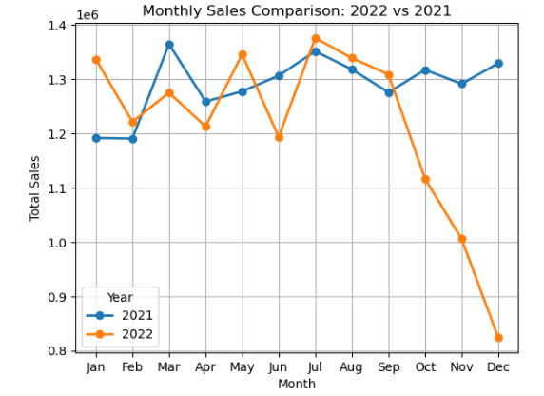
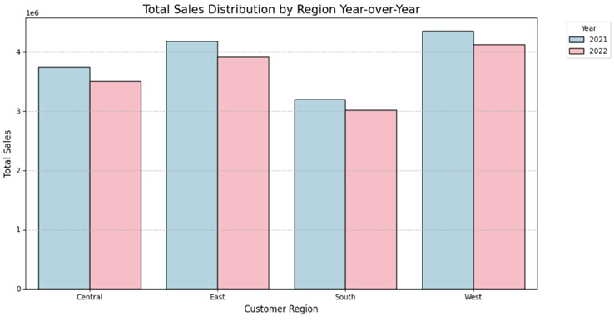
KPIs To Analyze Performance
YoY Monthly Sales Trends
YoY Region wise Sales Distribution
The trend infers growth in 2022 as compared to 2021 was stable till last quarter of the year but holiday season has a steep decline which is concerning for the company
All regions experienced a decline in sales in 2022 as compare to 2021
The Central region, although experiencing a decline, likely still has the highest sales, but the decrease is significant..

Slide 6
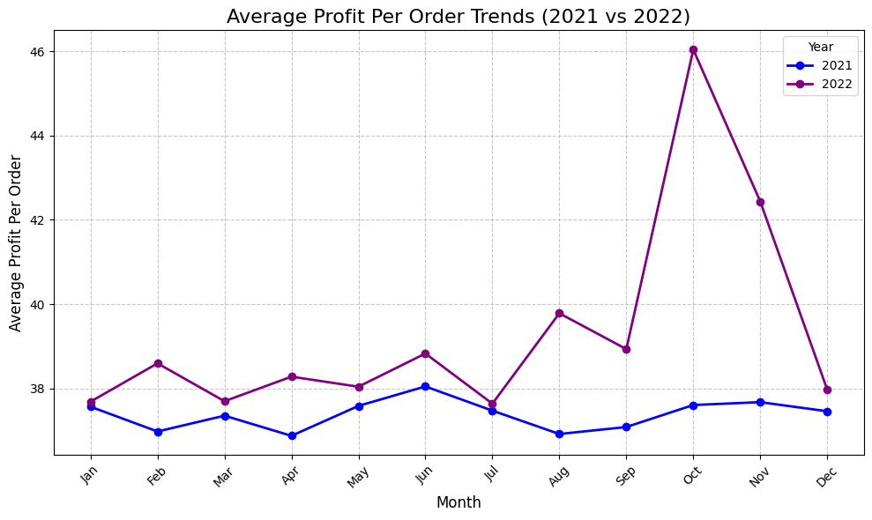
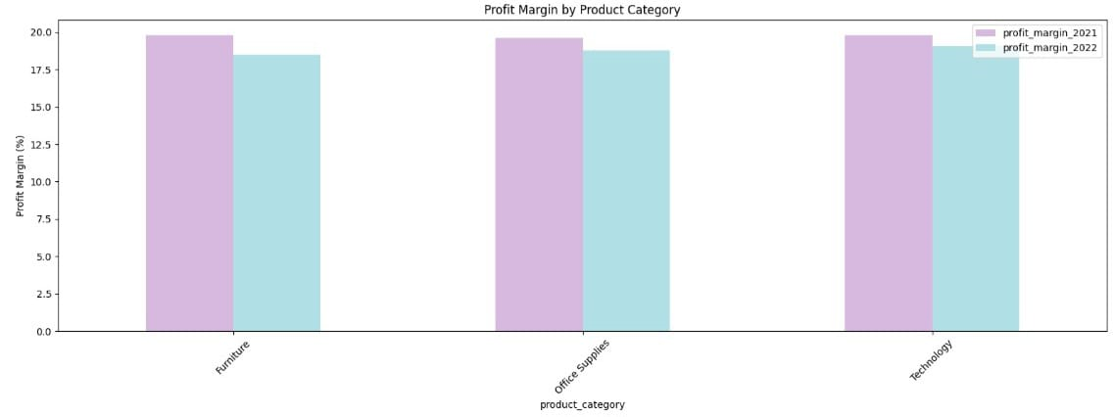
KPIs To Analyze Performance (cont.)
YoY Profit Per Order Trends
YoY Category Wise Profit Margins
2022 is having better profit per order trends peaking in October.
Even though there is a steep decline in sales value, profit per order peaked in October
The profit margin for all product categories has increased for 2022 from 2021.
Even though profit per order value is having upward trend in 2022, profit margins are lower when compared to 2021

Slide 7
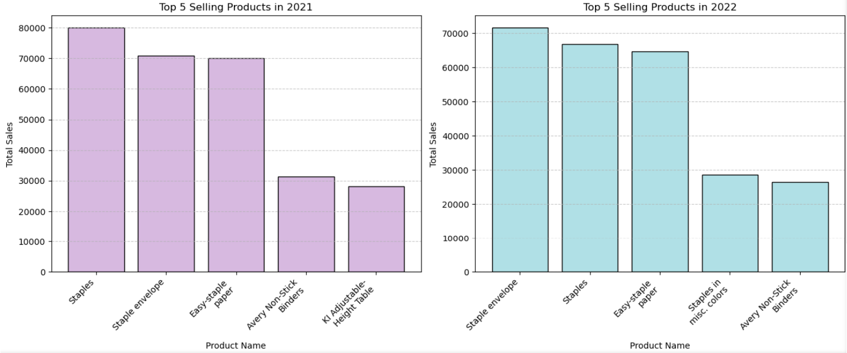
KPIs To Analyze Performance (cont.)
YoY Top Selling Products
"Staples" and "Easy-staple paper" consistently ranked among a positions varied between the years.
In 2022, "Staple envelope" emerged as the leading product, reflecting a shift in consumer preference.

Slide 8
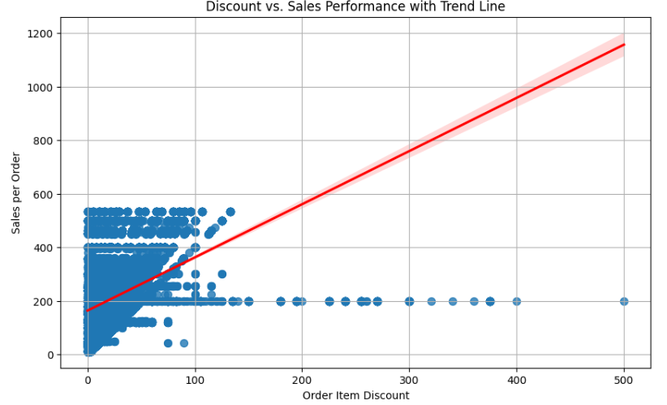
KPIs To Analyze Performance (cont.)
Discount v/s Sales Performance
Increased discounts generally lead to higher sales as indicated by red trend line.
Very high discounts show diminishing returns, indicating an optimal discount level for maximizing sales.

Slide 9
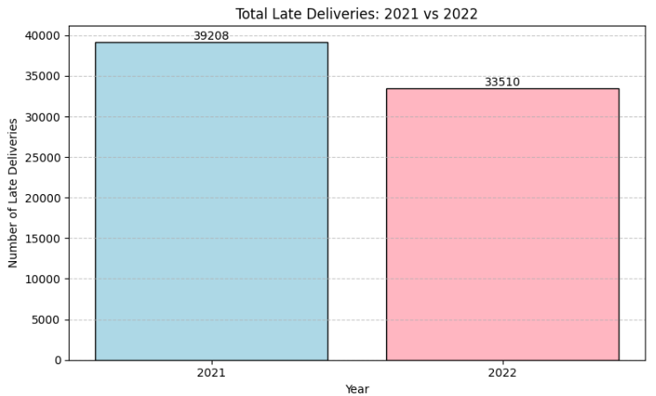
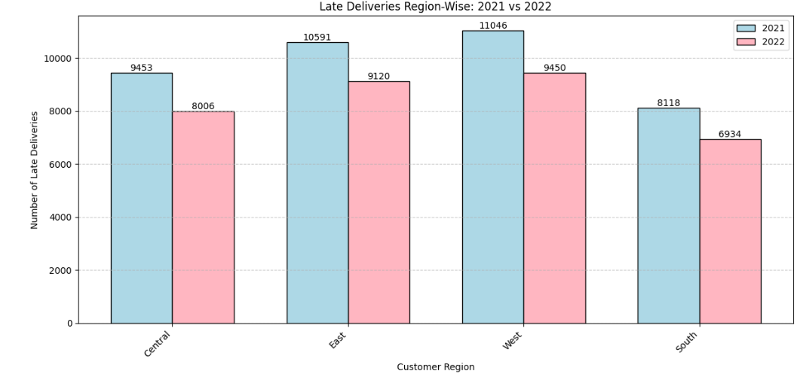
KPIs To Analyze Performance (cont.)
Overall late deliveries
Region Wise Late Deliveries
The number of late deliveries in 2022 declined by approximately 14.54% compared to 2021.
This shows an improvement in delivery performance over the year.
All the regions showed reduction in late deliveries
East – 13.9%
West – 14.4%
Central – 15.3%
South - 14.6%
The Central region saw the largest decrease at 15.3%, while the East region had the smallest reduction at 13.1%.

Slide 10
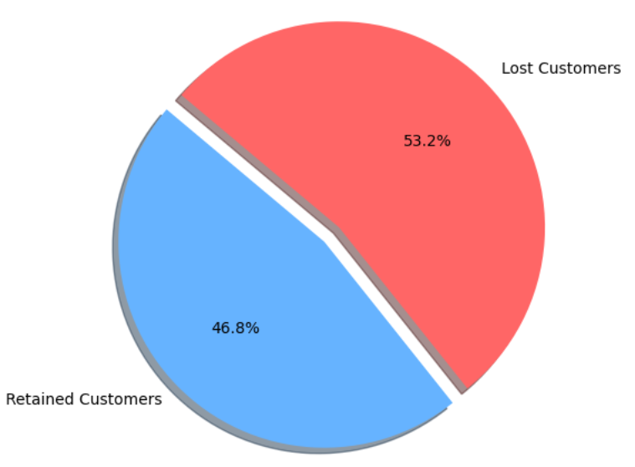
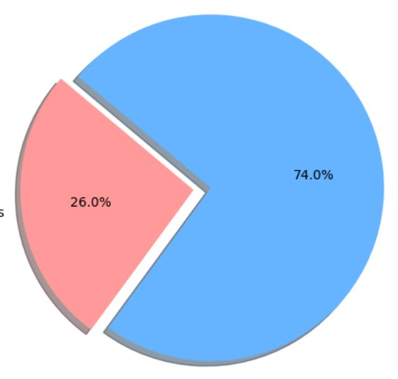
KPIs To Analyze Performance (cont.)
Customer Retention - 2022
Impact of Late Deliveries on Retention-2022
Lost customers without late deliveries
Lost customers with late deliveries
Customer retention stands at 46.8%, while the customer loss rate is 53.2%, indicating a need to enhance strategies to improve customer loyalty and reduce attrition
Out of the churned customers 26% experienced late deliveries.
Since 74% of churned customers had no late deliveries, other factors must be driving churn.

Slide 11

Actionable Insights
Holiday Sales Decline: Increase targeted promotions and limited-time discounts, as there is a steep decline in Sep-Dec 2022.
Late Delivery Reduction: Improve delivery times that might improve the customer retention rate.
Regional Sales Decline: Focus on region-specific marketing strategies.
Profit Margins: Adjust pricing and introduce bundling and loyalty programs.
Customer Retention: As customer churn rate is more than 50 % ,gather feedback and offer personalized loyalty programs.
Discount Strategy: Stick to moderate discounts (20-30%)

Slide 12

Code Walkthrough

Slide 13

Questions

Slide 14


